Slide 1


By Janek Uchman

Slide 2
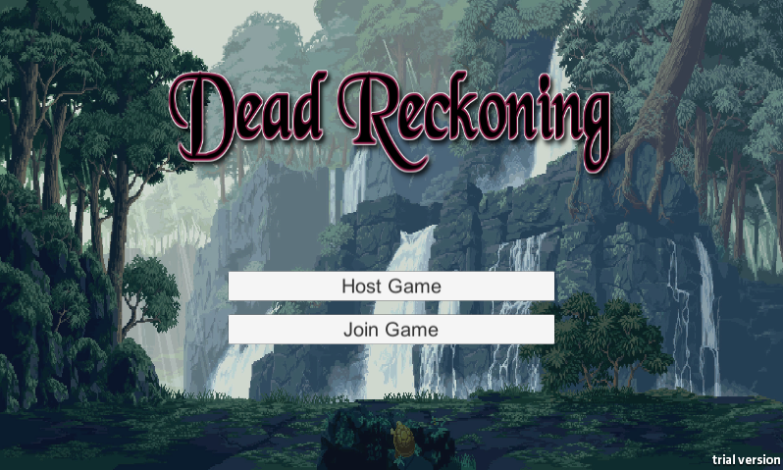
A brief run through of the game

Slide 3

A brief run through of the game

Slide 4

A brief run through of the game

Slide 5
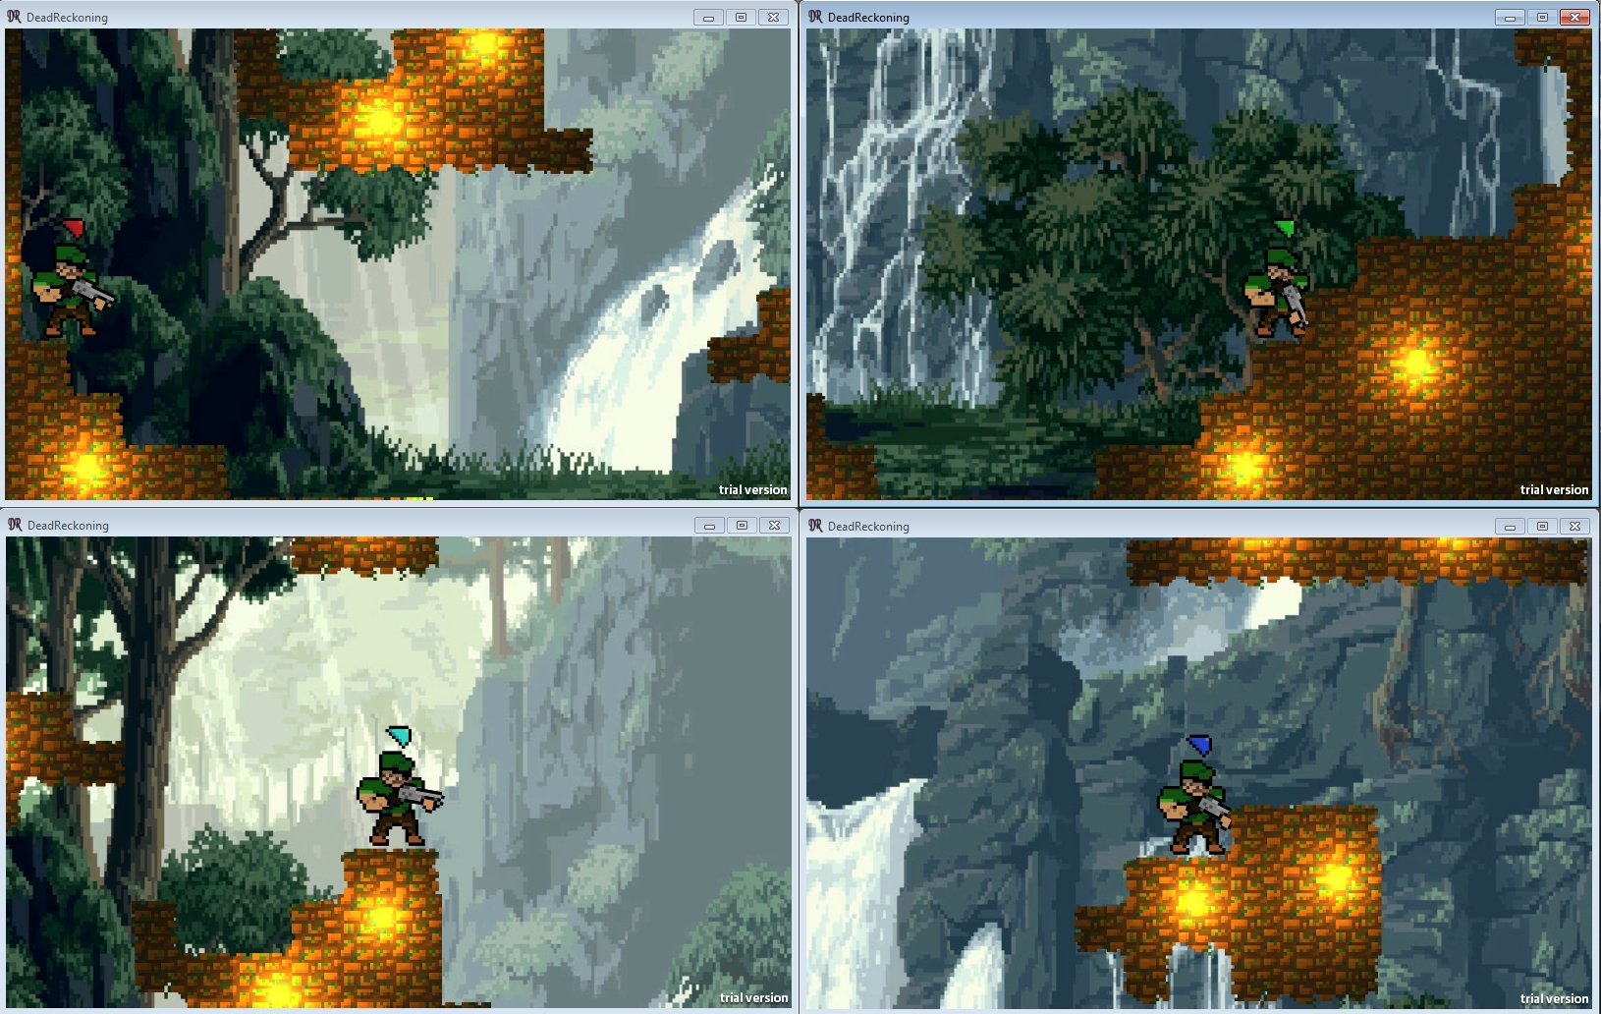
A brief run through of the game

Slide 6
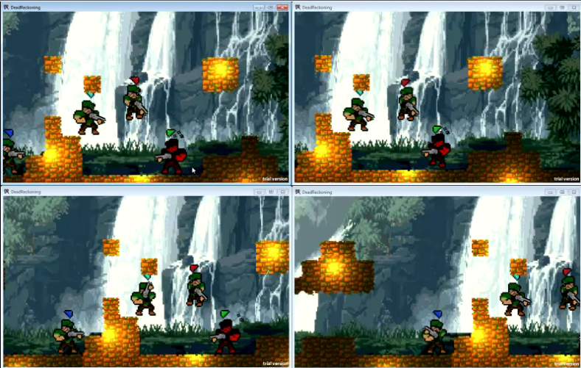
A brief run through of the game

Slide 7
A brief run through of the game
Enemy players controlled through component
Player has separate components
Additional players handled client side

Slide 8
Networking layout
.NET Sockets/TCP
Server-Client
Async using select and Unity coroutines

Slide 9
Packet Pipeline
Object “DataPacket” created
DataPacket serialized
DataPacket written/read from stream
DataPacket deserialized
If host DataPacket added to redistribution
Action based on DataPacket contents

Slide 10
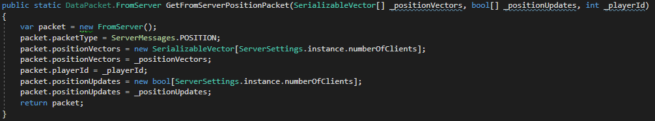
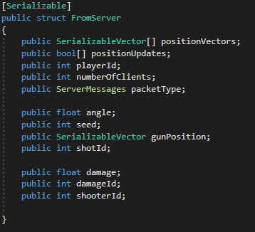
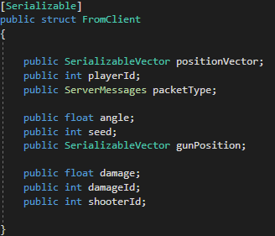
DataPacket

Slide 11
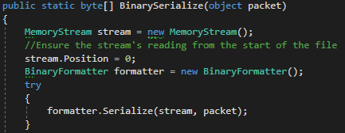
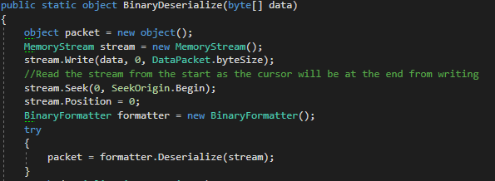
Serialization

Slide 12
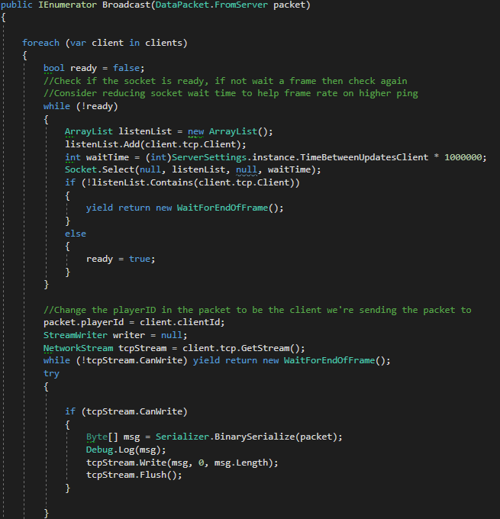
Distribution

Slide 13
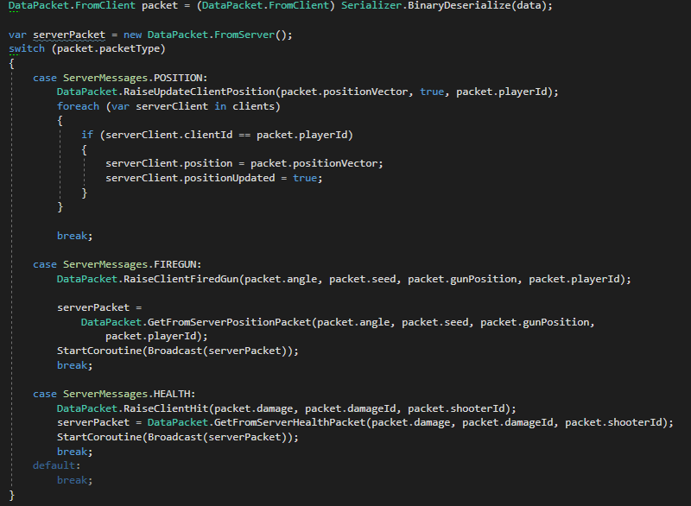
Handling the packet

Slide 14
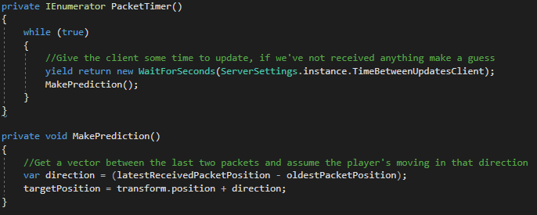
Prediction

Slide 15
Downfalls
Skating
Client side hit detection
UDP for positional updates

Slide 16
Occasional serialization packet loss solutions
Asynchronous Send/Receive
Send everything as one packet
Different serialization methods

